Slide 1
Liquid Metal Ion Source
Nima Khadem Mohtaram
Department of Mechanical Engineering
November 2011

Slide 2
What is LMIS ?
In a Liquid metal ion source (LMIS), a metal (typically gallium) is heated to the liquid state and provided at the end of a capillary or a needle. Then a Taylor cone is formed under the application of a strong electric field. As the cone's tip get sharper, the electric field becomes stronger, until ions are produced by field evaporation. These ion sources are particularly used in ion implantation or in focused ion beam instruments.

Slide 3
What is LMIS?
An LMIS is a field ion emission source. Such sources generate high–brightness positive ion beams from neutral atoms or molecules, by field–induced ion formation at the tip of a needlelike emitter.

Slide 4
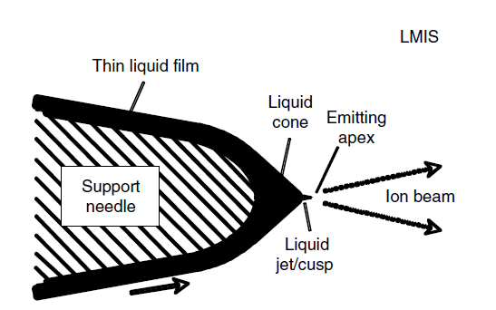
Operating needle
The normal LMIS can use
Pure Metal
Alloy
liquid alloy ion source (LAIS)

Slide 5
History of LMIS
Early observations:
Gilbert (1600): fluid under high tension forms a cone
Zeleny (1914): Observed and filmed cones and jets
Taylor (1964): exactly conical solution to equations of Electro Hydro Dynamics (EHD)

Slide 6
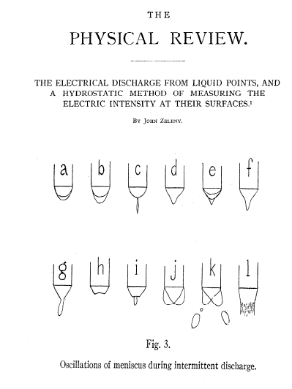
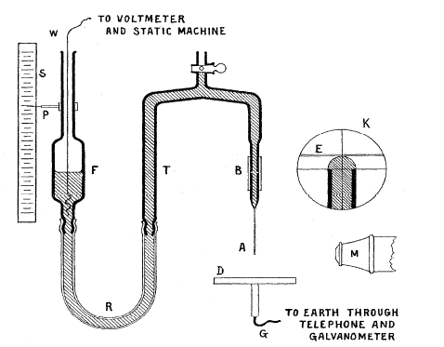
Early work
Zeleny 1914: he took excellent ultra fast
pictures of TC moving the photo plaque with
a rubber band! Inventor of Zeleny
Electroscope (University of Minesota)

Slide 7
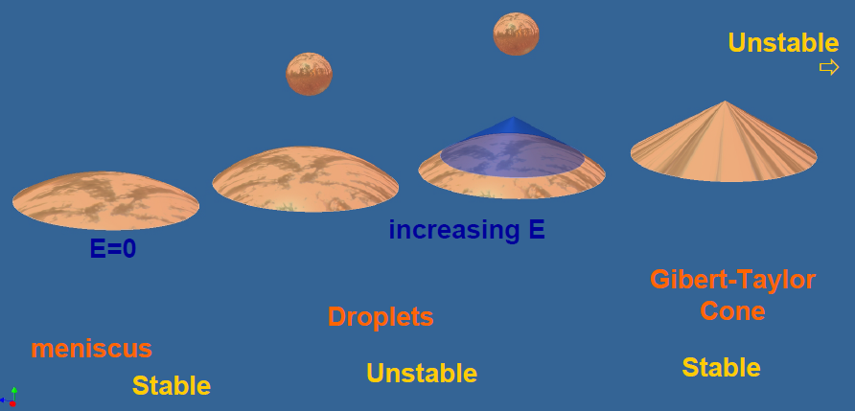
Interaction Electric field - Liquid surface
Electrostatic energy and surface tension energy

Slide 8
Why LMIS?

Slide 9
Comparison of Various Ion Sources

Slide 10
Requirements For The Ideal Liquid Metal Ion Source
A Low Melting Temperature
Low Volatility at the Melting Temperature
High Relative Bulk Concentration of Ion Species of Interest
Low Surface Free Energy and Good Wetting
Low Solubility of Alloy in Substrate
Low Solubility of Substrate in Alloy
Favorable Mechanical, Electrical , and Vacuum Properties

Slide 11
Ion sources for FIB

Slide 12
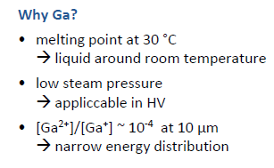
Ga source: LMIS
very high special coherence, i.e. focusable beam!

Slide 13
Ga source: LMIS
Coil for heating, also serves as Ga reservoir
Ga forms a Taylor Gillbert cone

Slide 14
Operation Principle of LMIS

Slide 15
Operation Principle of LMIS
By applying an electric potential between the needle and a downstream metallic extractor, a structure known as a Taylor cone is formed at the tip of the needle. Once we exceed a threshold voltage, ions and droplets are extracted from the cone, and pass through a hole in the extractor.

Slide 16
Advantages
Liquid Metal Ion Sources (LMIS)
LMIS is the answer to high resolution, focused ion beam (FIB) imaging, nanofabrication, depth profiling, SIMS*, ion doping and ion beam lithography. FEI uses LMIS in a variety of configurations: FIB columns, FIB systems, and DualBeam systems.
Advantages
High angular intensity
Stable emission process

Slide 17
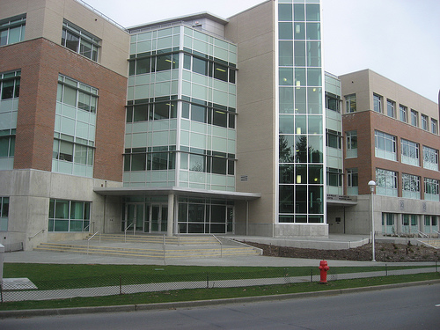
Thanks for your kind attention
STEHM
(HF 33XX) coming!

